Slide 2
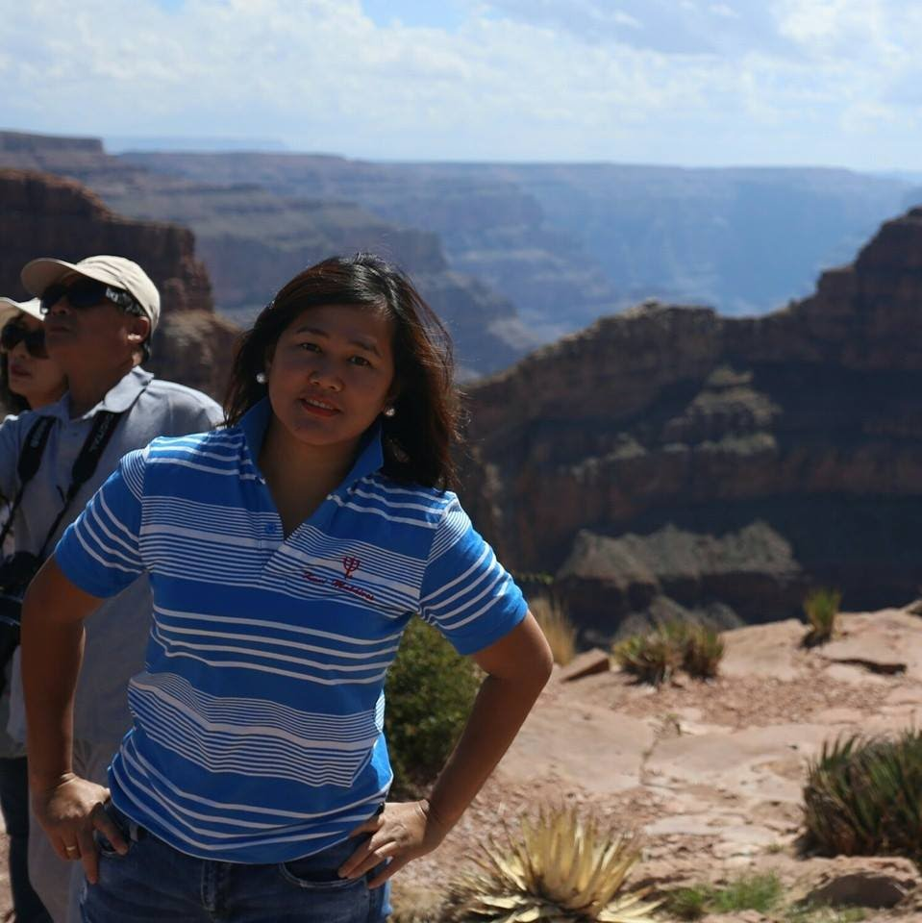
“ I hate packing. I always feel like I’m forgetting something.”

Slide 3

“A cyclone ruined my trip and I was forced to stay indoors the whole time.”

Slide 4
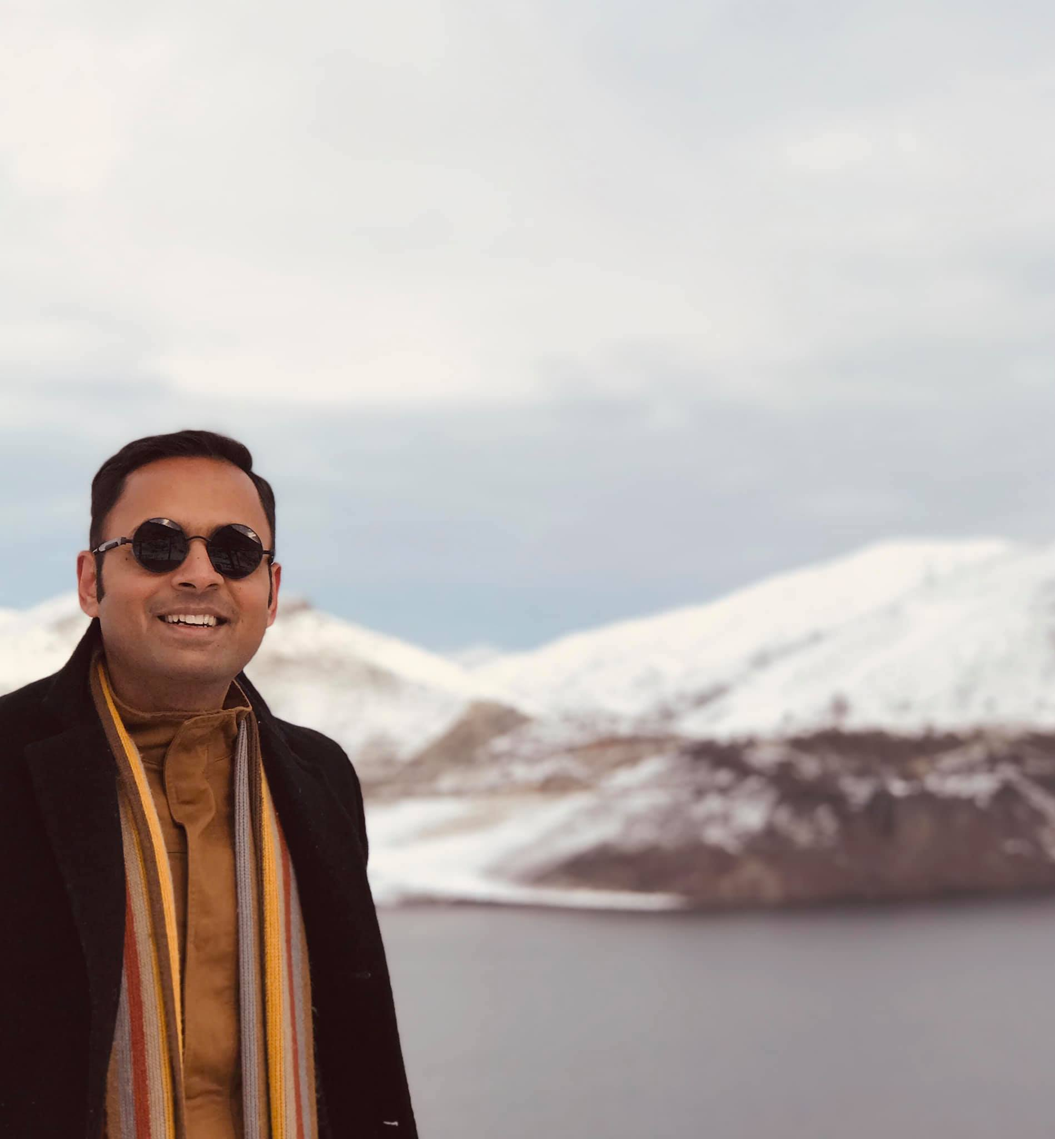
“Sometimes it's hard to find vegetarian food.”

Slide 5
Happy Journey

Slide 6
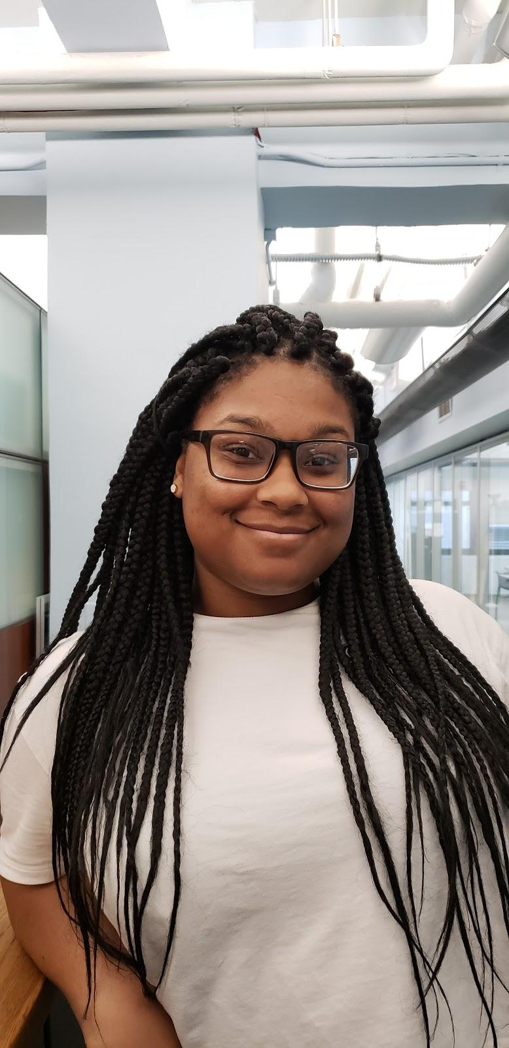
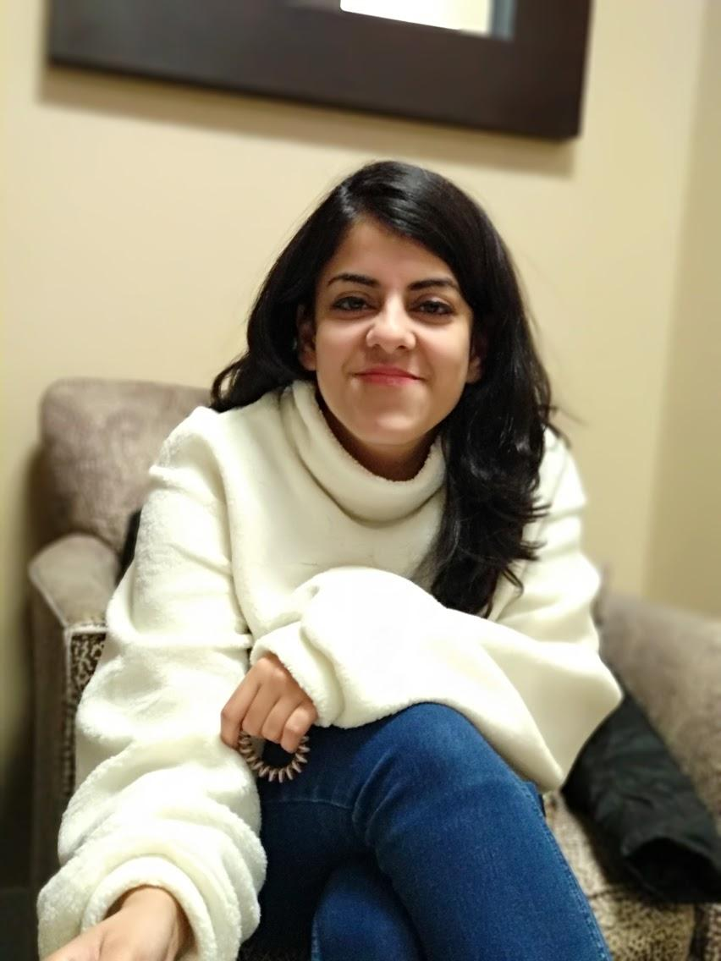
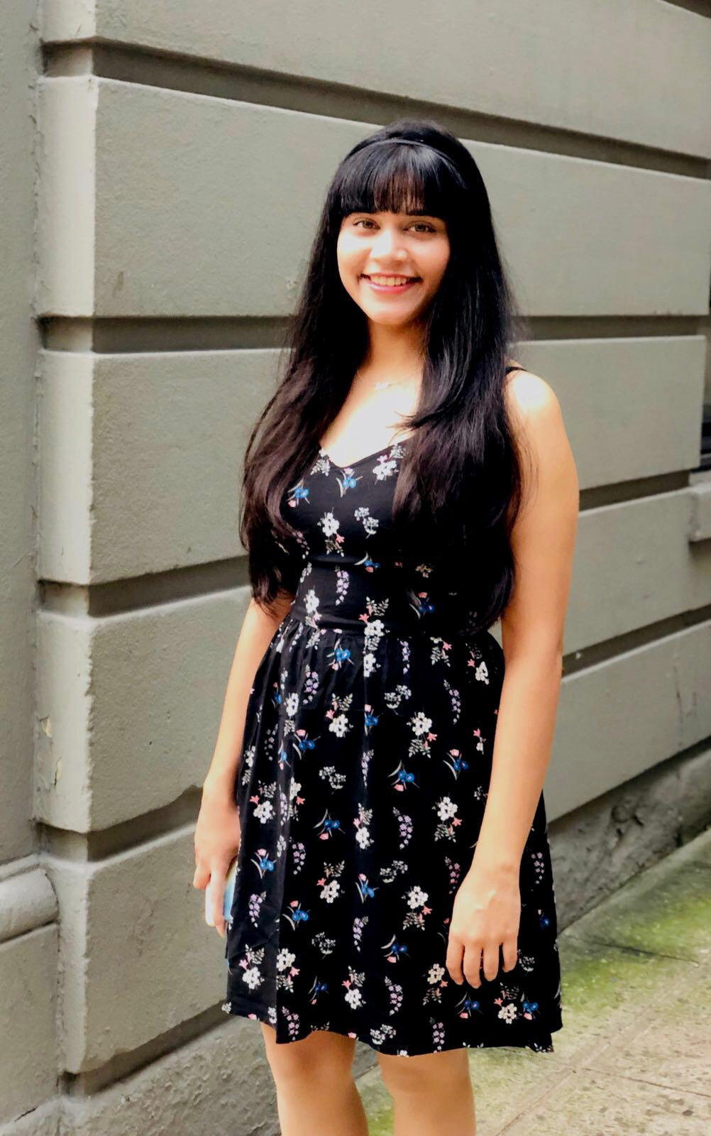
Hello!
We are Team 6
We are here because we love to improve User Experience.
Presented by-Jennifer Rhau, Kajal Purwar, Sanchita Ochani
Notes:
KAJAL
Introduce us as team

Slide 7
Traveling is such a tedious task, we wanted to ease the experience.
Notes:
KAJAL
This is our problem statement. After our initial research this is what we decided we had to fix

Slide 8
Goal
“Our goal is to enhance the planning process of a trip, and at the same time, make it stress-free.”
Notes:
KAJAL

Slide 9

Personas
This is Naiomy from Paris. She is currently working as Manager at Dyckman Farmhouse Museum. She loves history, reading and meeting new people. She has traveled to more than 15 countries.
She is always ready to try new things and explore new countries. She spends her weekends networking and at meetups. She attends art events and conferences on regular basis around the globe.
She finds it hard to plan out all her trips to the minute.
She hates packing.
Name: Naiomy Rodriguez
Age: 30
Profession: Manager at a museum
Hobbies: History, Reading, Traveling, Music.
Prototype
Notes:
KAJAL
Jennfier
kajal - Naiomy is already using happy journey and here is her planning to the back and forth trip to paris to nyc. whenever, She wants, she can add anything right away.

Slide 10
Gaps in Existing Apps
Most websites like Kayak only help you with flight and hotel bookings, without focusing on the other aspects of planning a trip.
Apps like Yelp can only be reliable in countries where the app usage is heavy.
Notes:
Sanchita
Comparative Analysis -
Kayak does this … this place does that, but we come and bring allt hose funcitonalities together

Slide 11
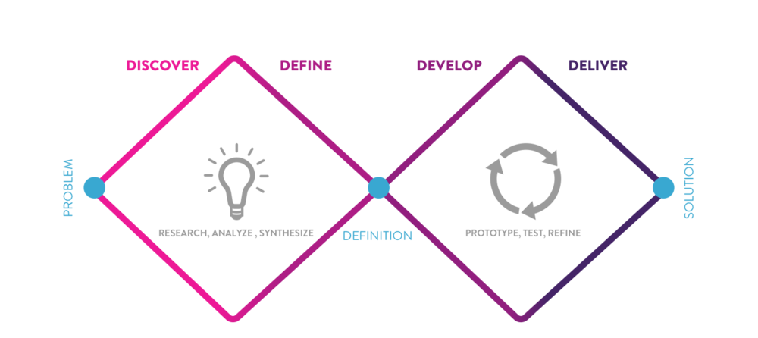
Process
Notes:
Sanchita
We used this process for our research

Slide 12
DISCOVER
Notes:
Sanchita
Discover is the first part of our project
Here is what it entails

Slide 13
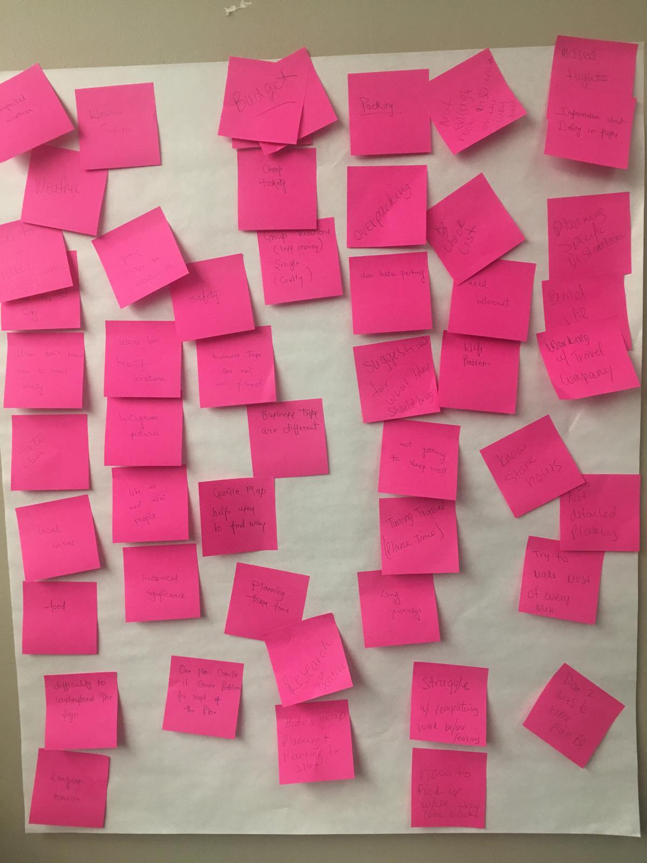
Research Outcomes
Users hate packing.
Users can’t keep track of their expenses.
Users struggle with planning.
Wall full of ideas
Notes:
Sanchita
Talk about findings

Slide 14
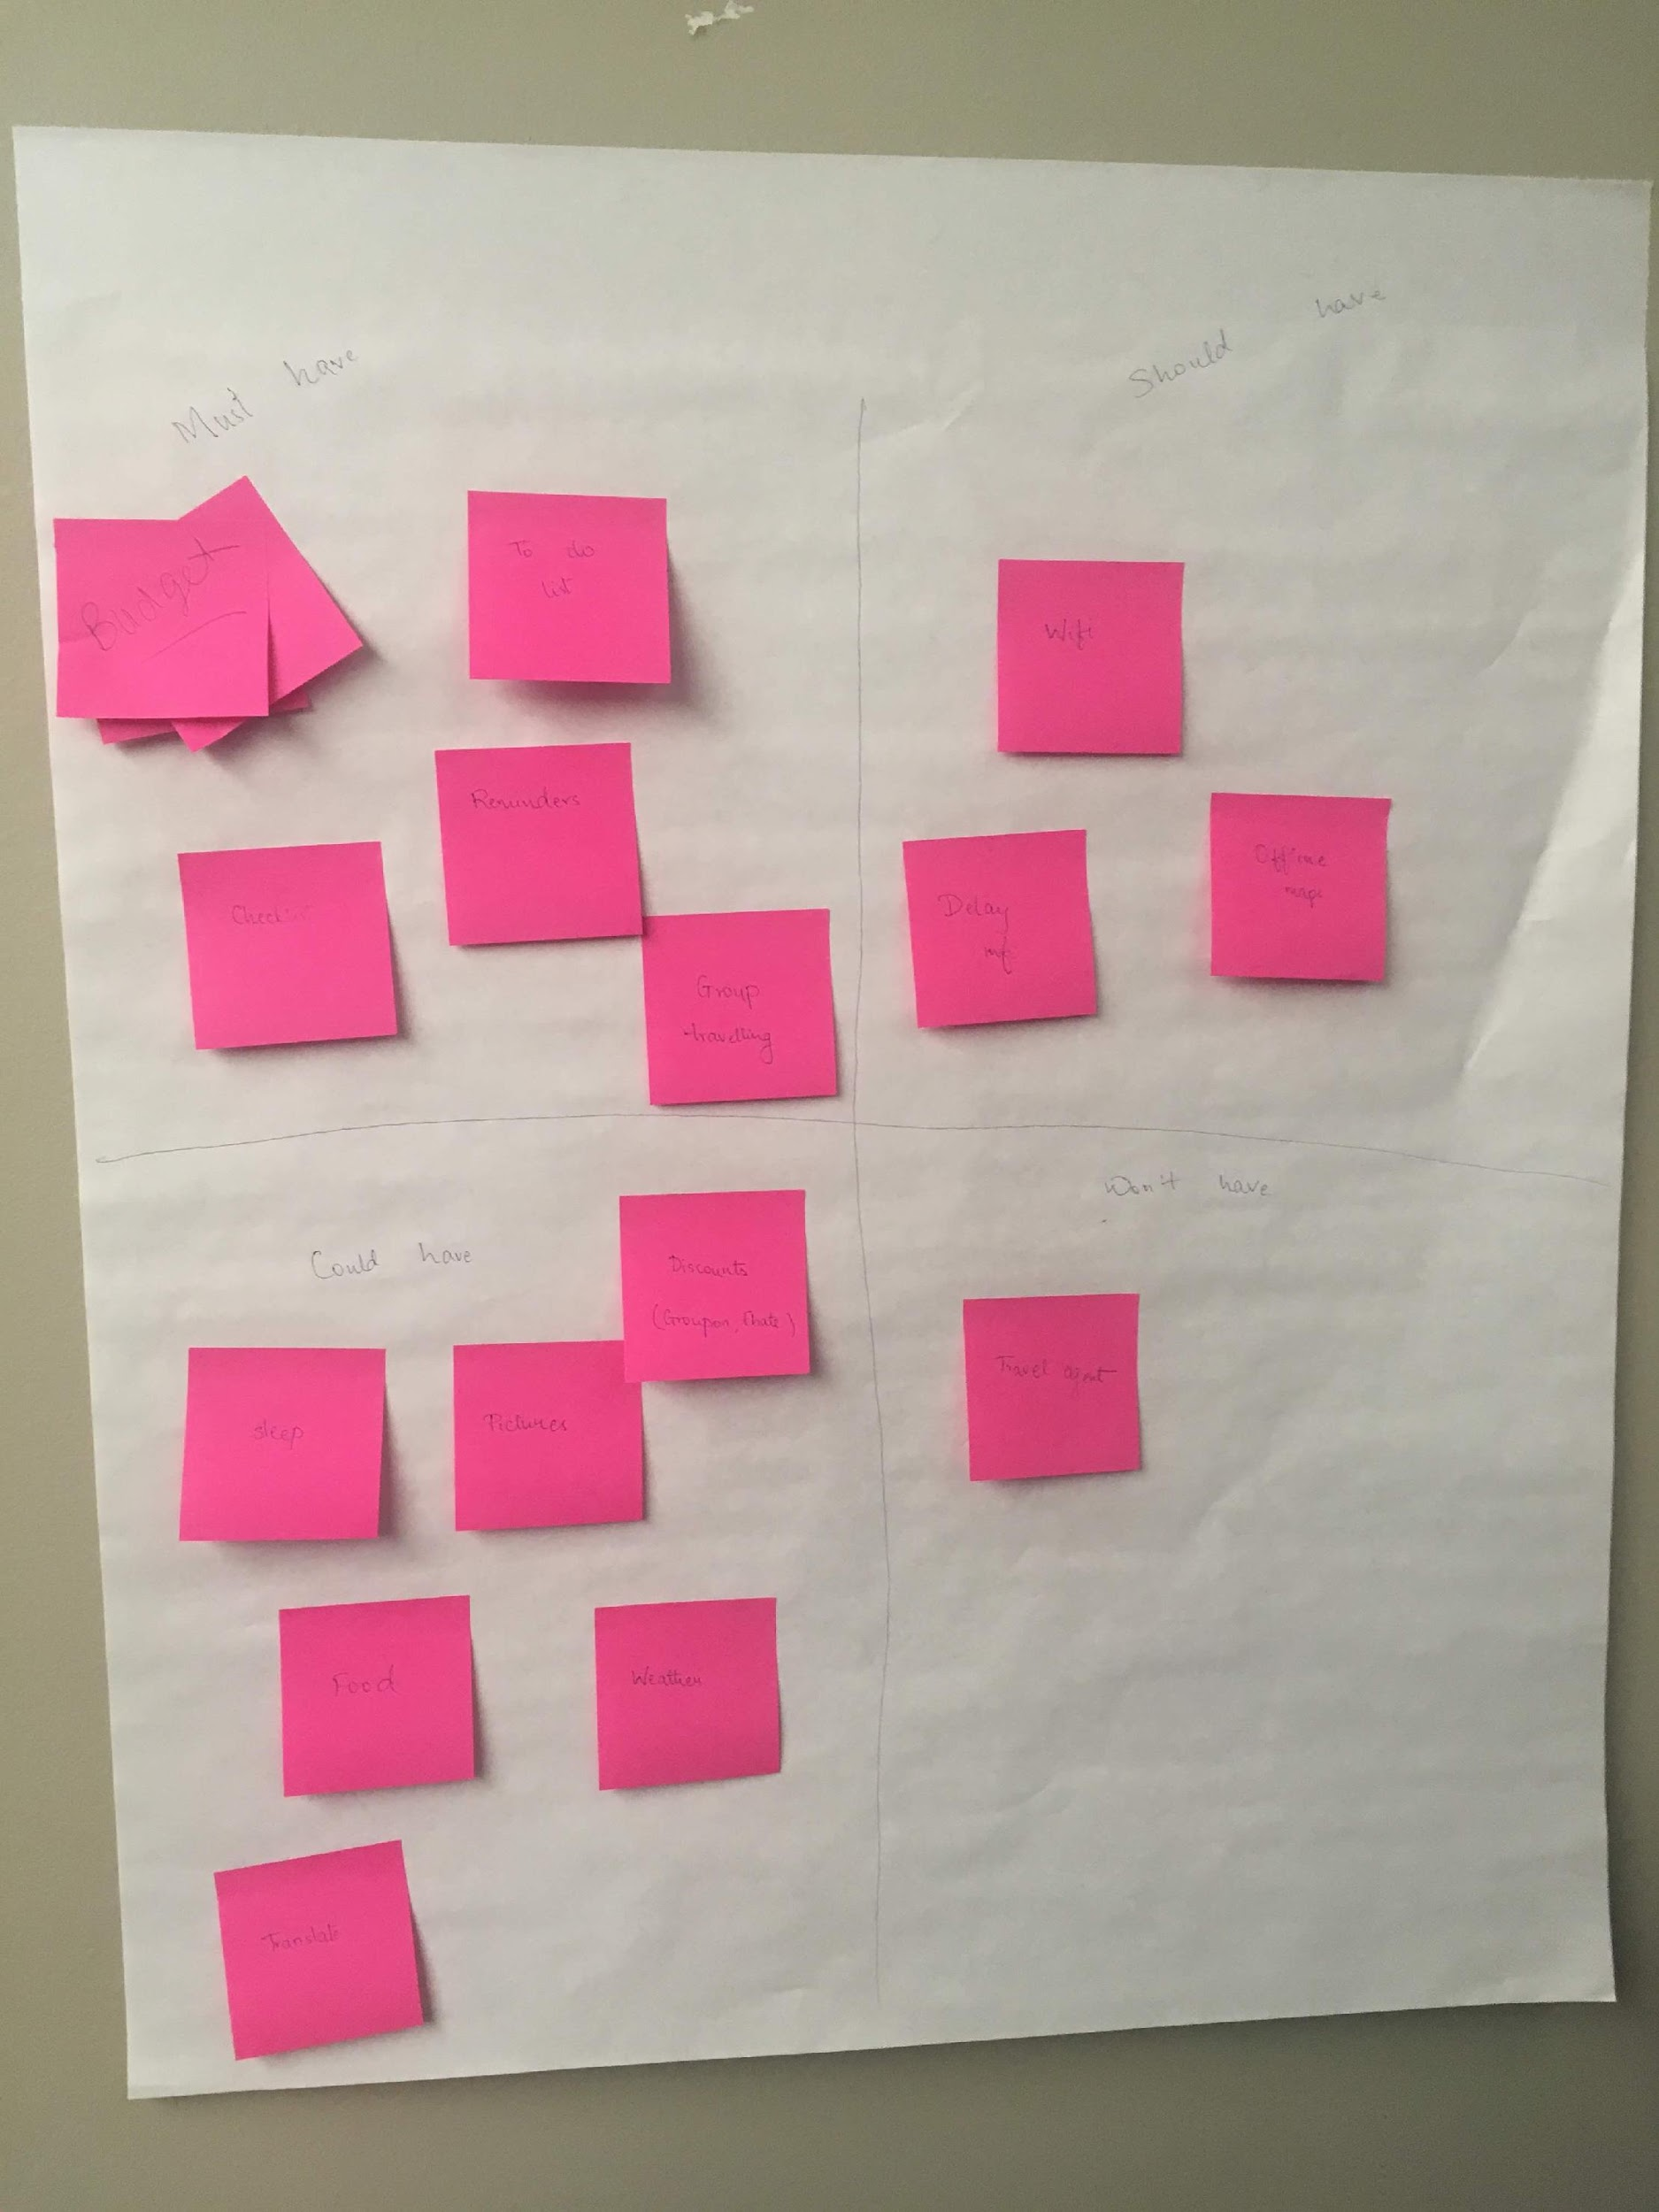
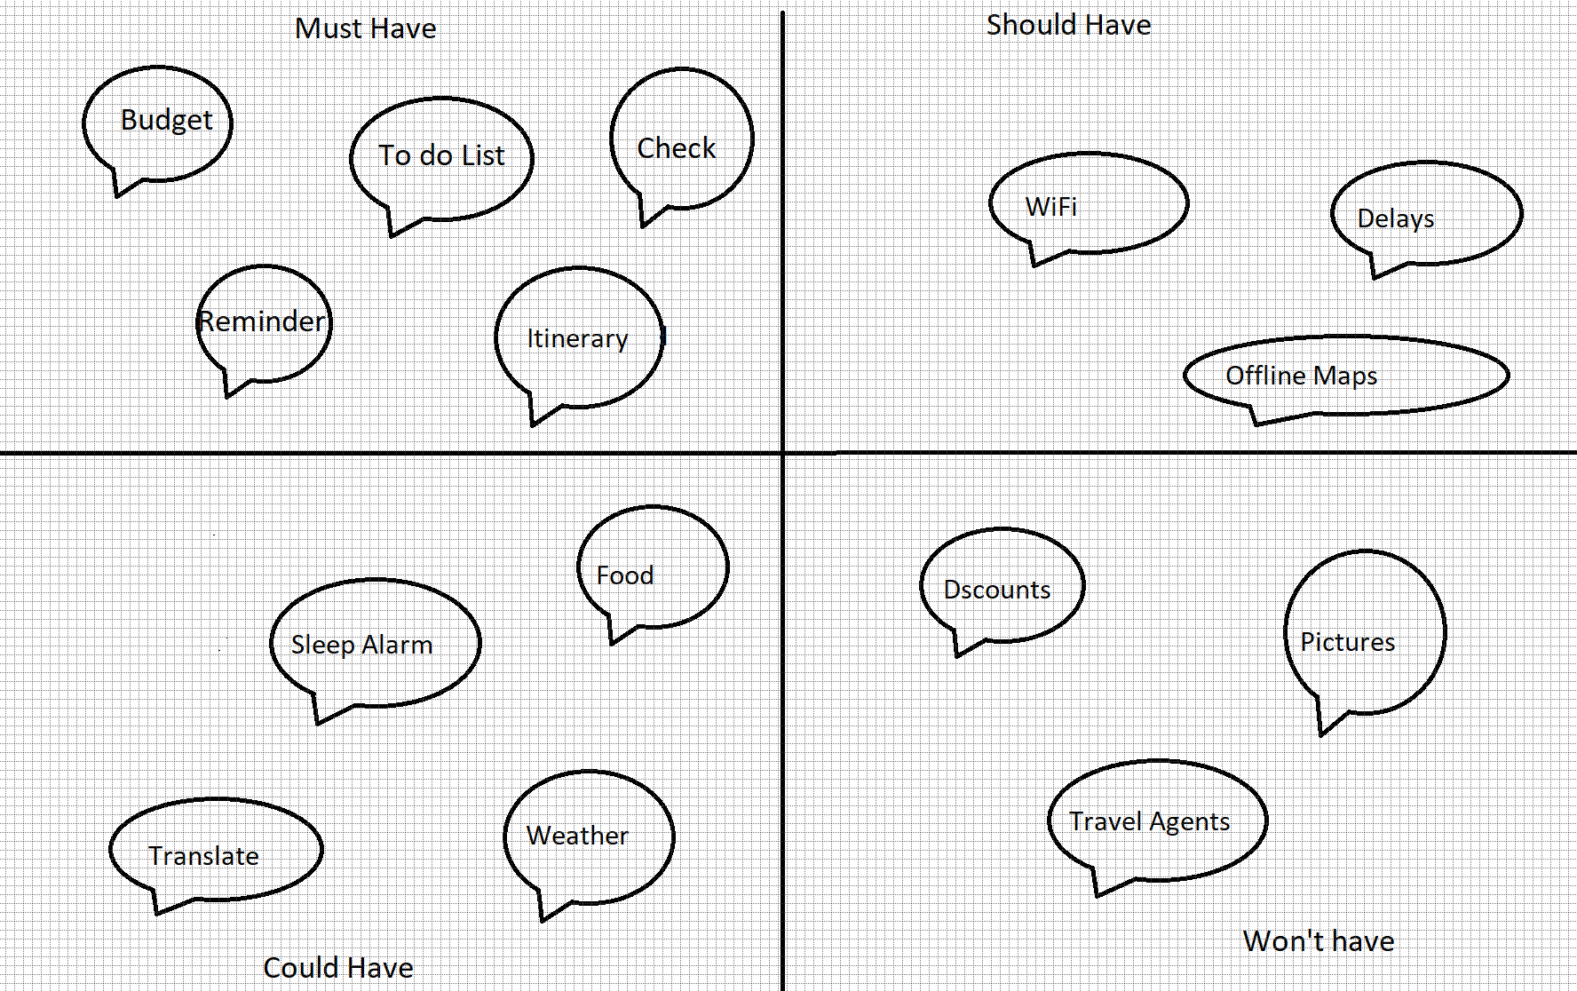
MOSCOW
Notes:
Sanchita will do moscow

Slide 15
Define

Slide 16
We need a one-stop
solution to all traveling woes

Slide 17
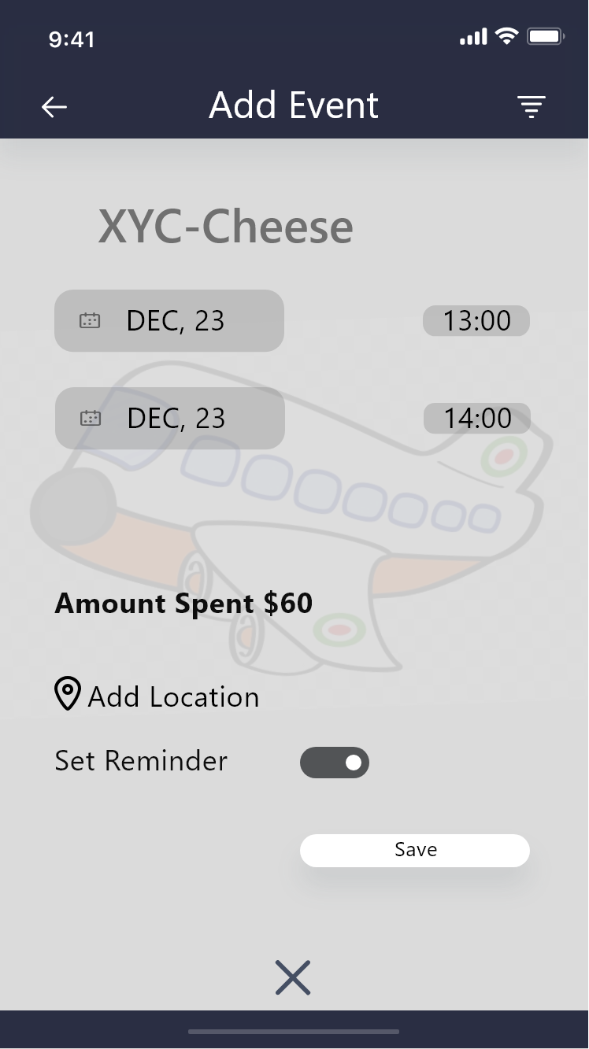
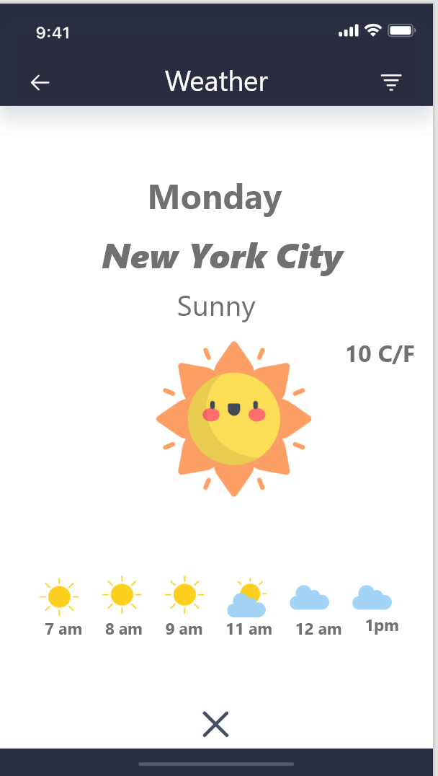
HEURISTICS
User control and freedom
Flexibility and efficiency of use
Consistency and standards
Aesthetic and minimalist design
Match between system and the real world
Notes:
Jennifer Rhau
**ADD A PICTURE OF APP SCREEN**

Slide 18
DEVELOP

Slide 19
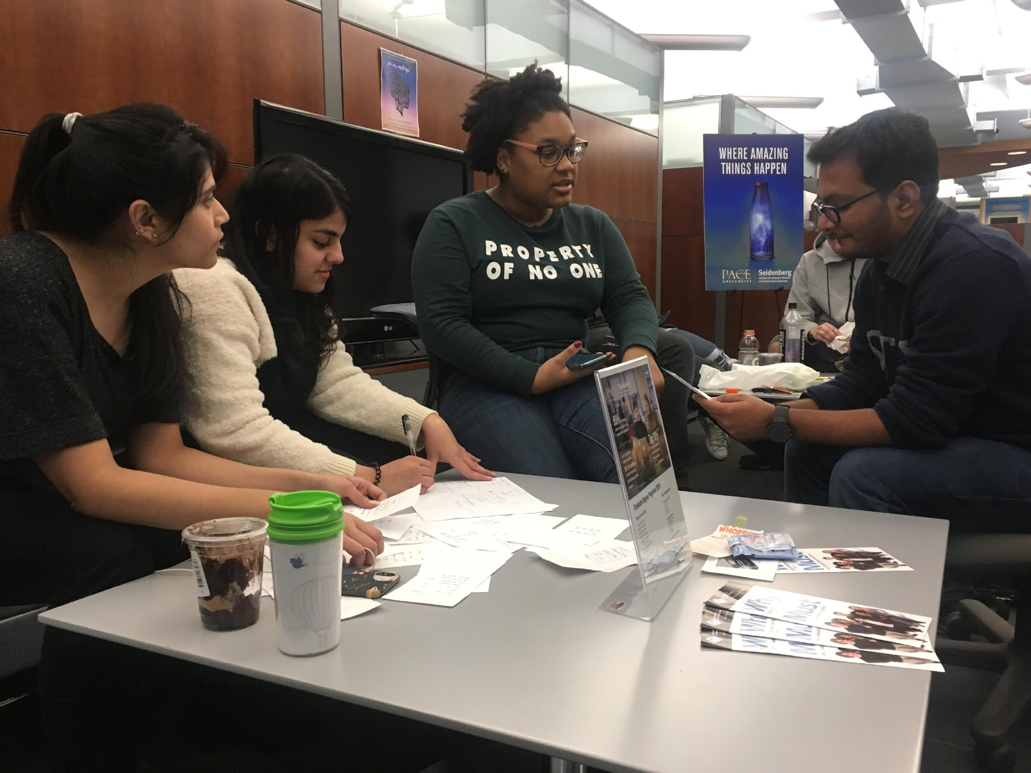
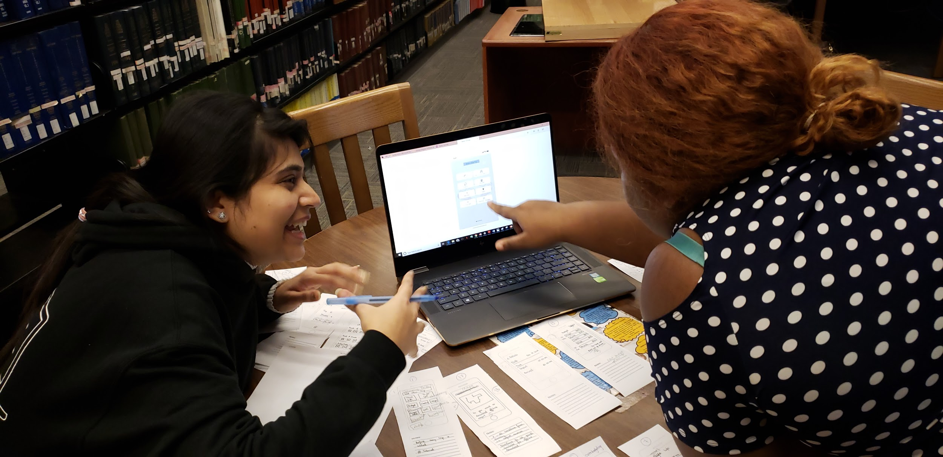
Usability Testing
Notes:
Sanchita

Slide 20
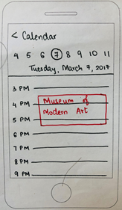
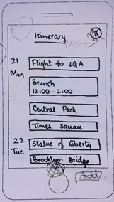
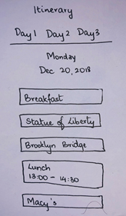
Major Changes in Itinerary

Slide 21
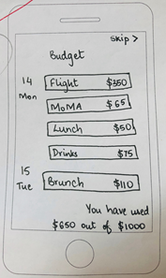
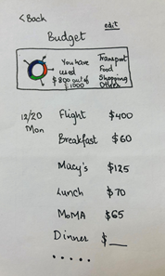
Major Changes in Budget

Slide 22
Deliver
Notes:
Sanchita

Slide 23
Solution
Notes:
Jennifer
.. So after all of this we decided to create what you saw in the prototype:
Budget Page
Itinerary
Recommendations
Mapped out destinations

Slide 24
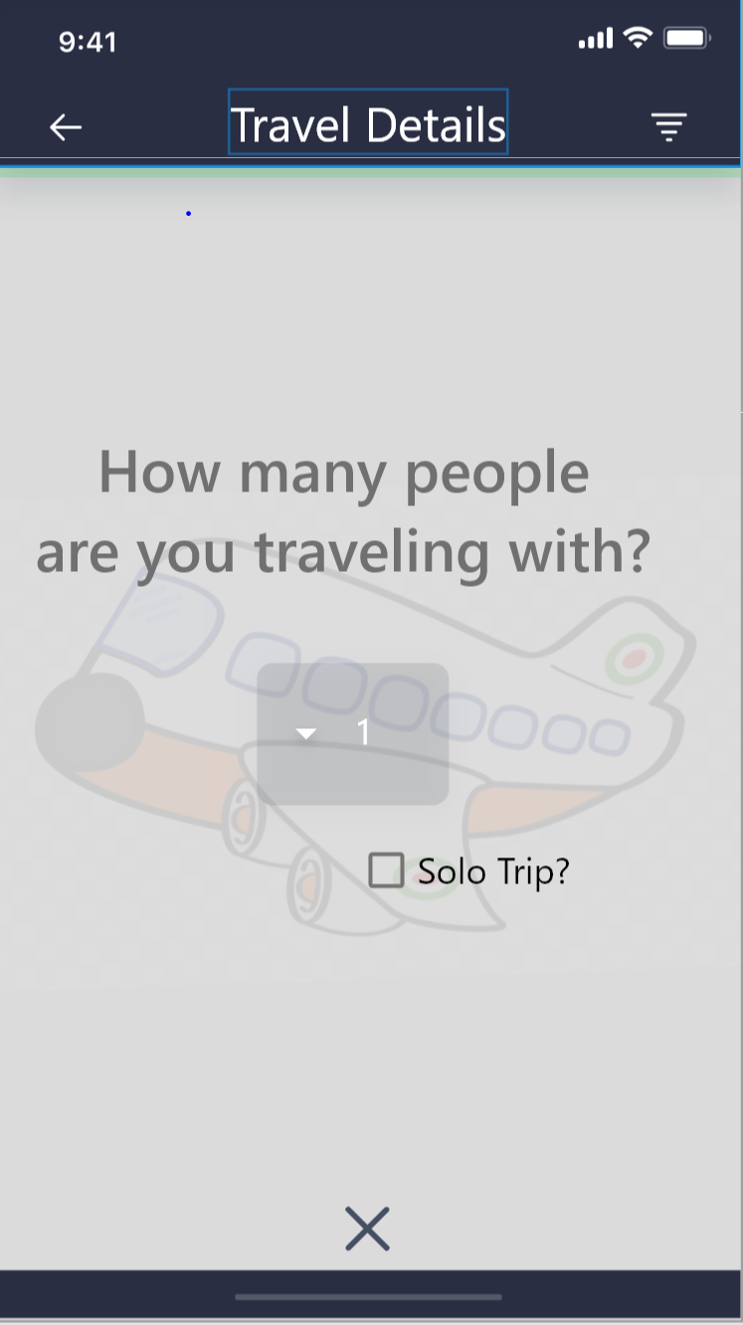
Group collaboration
Share with friends feature
To be continued...
Notes:
Jennifer

Slide 25
Thanks!
Any questions?

